Slide 1




Week-3 (Discussion)
12th August, 2024
Introduction to Machine Learning
Prof. Balaraman Ravindran
Professor and Head of the Department
Department of Data Science and Artificial Intelligence
IIT Madras
Ayan Paul
PMRF Research Scholar
IIT Kharagpur

Slide 2
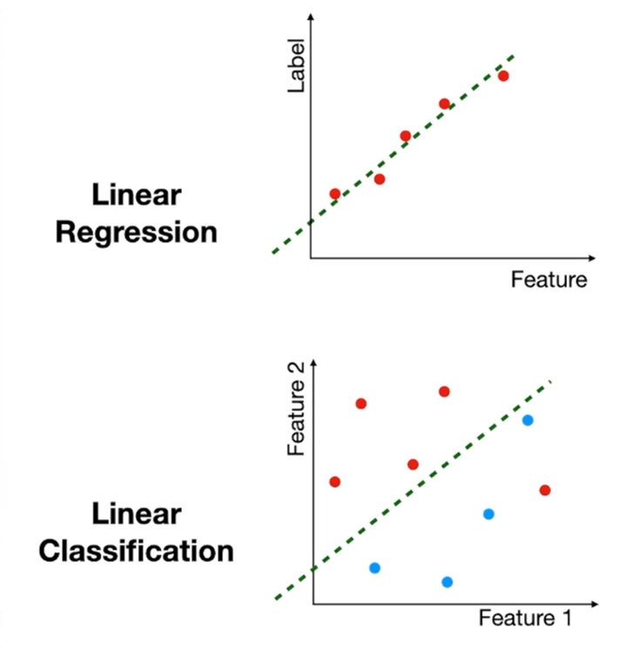
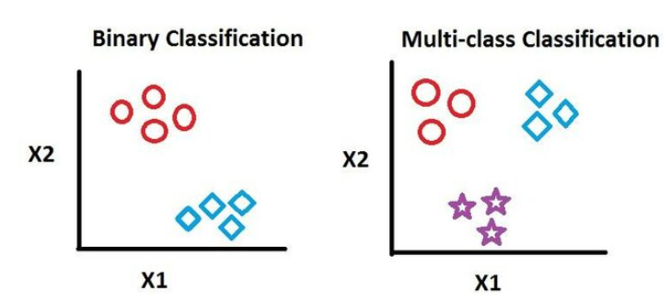
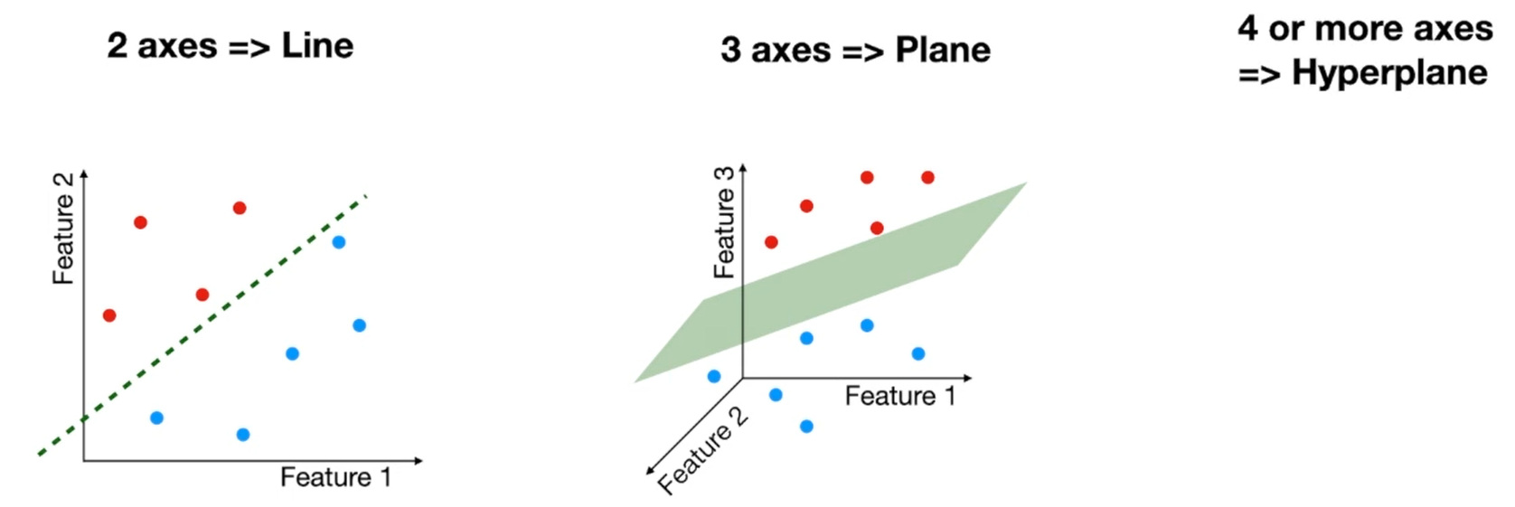
Linear Classification
Linear Classification refers to categorizing a set of data points into a discrete class based on a linear combination of its explanatory variables.

Slide 3
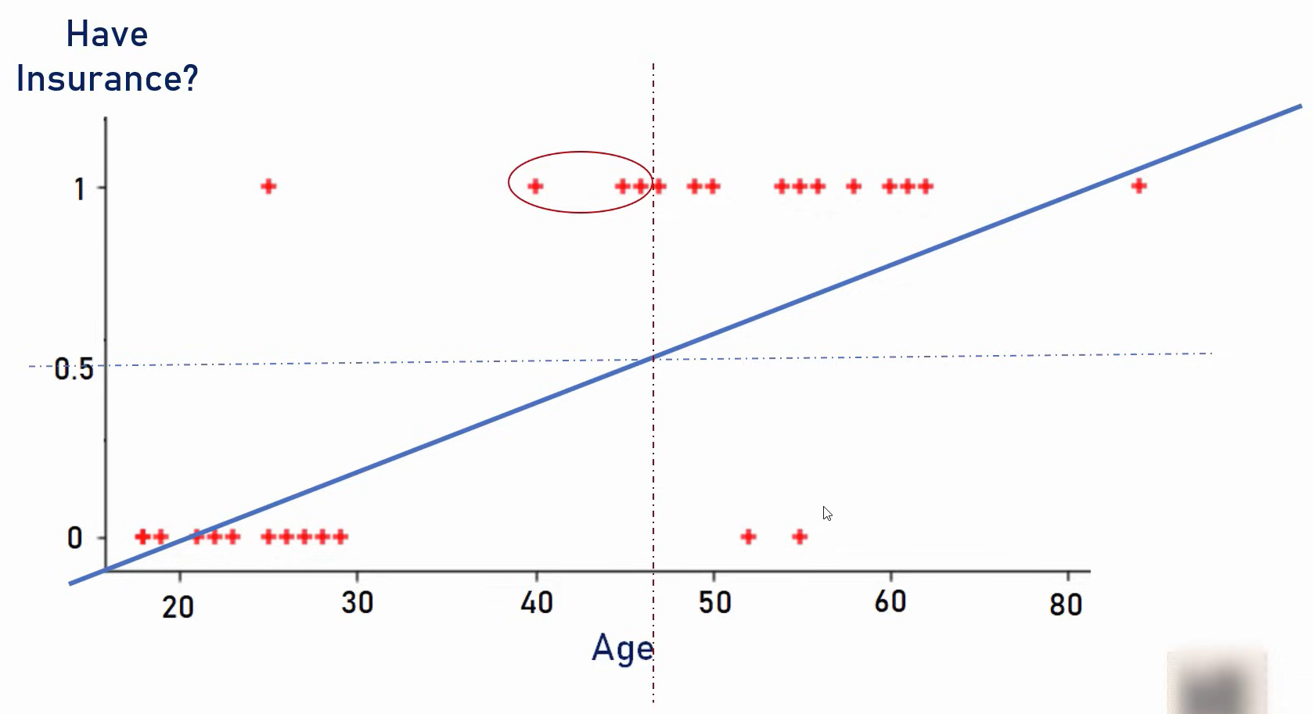
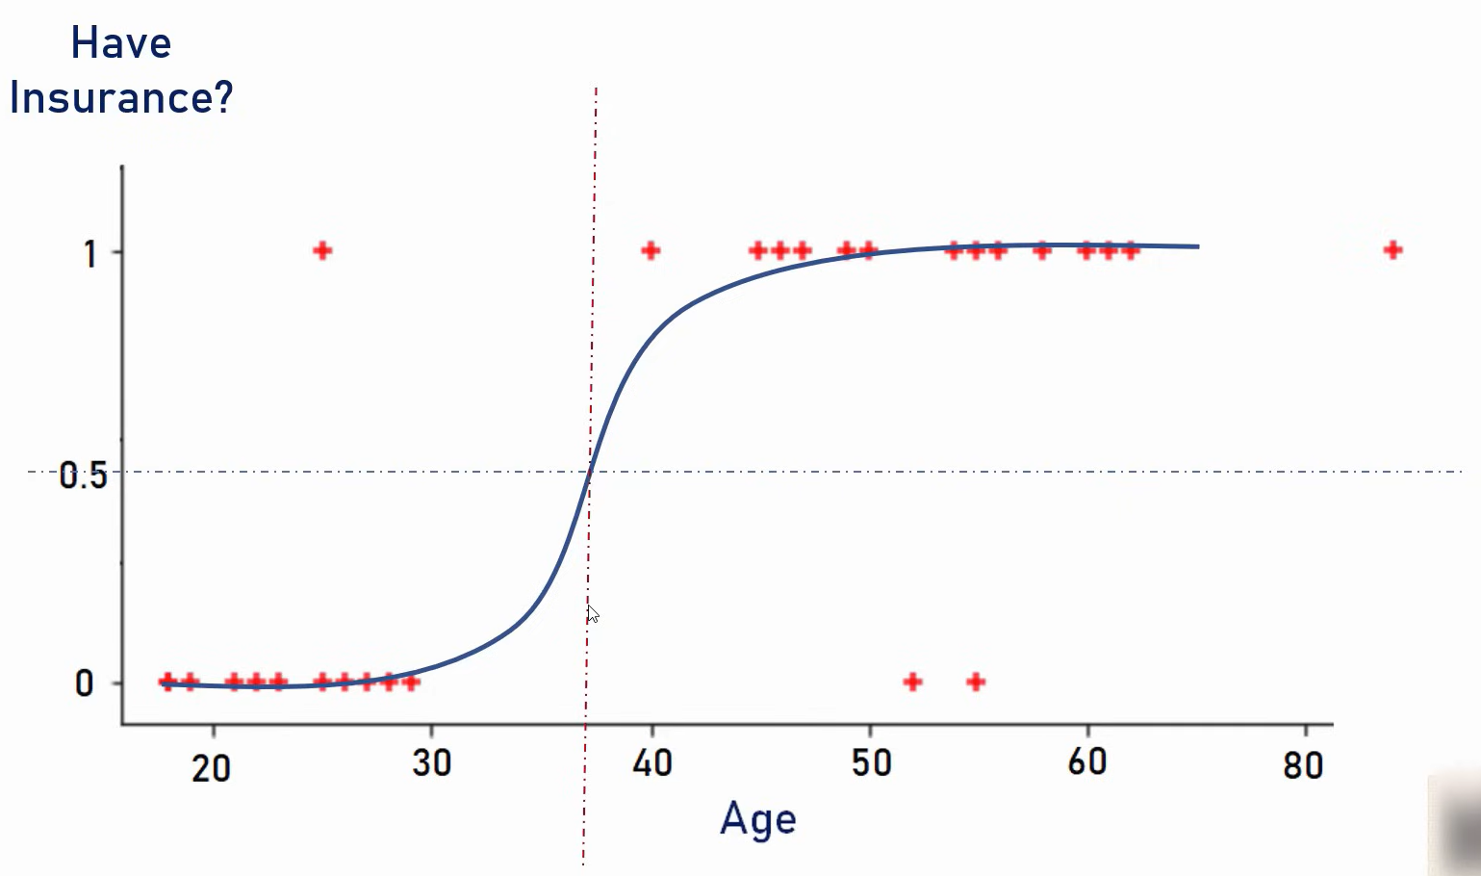
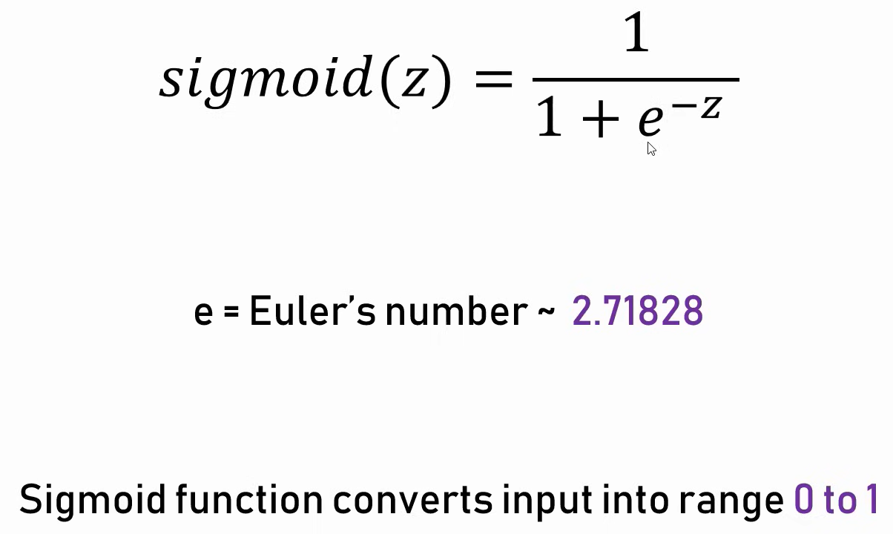
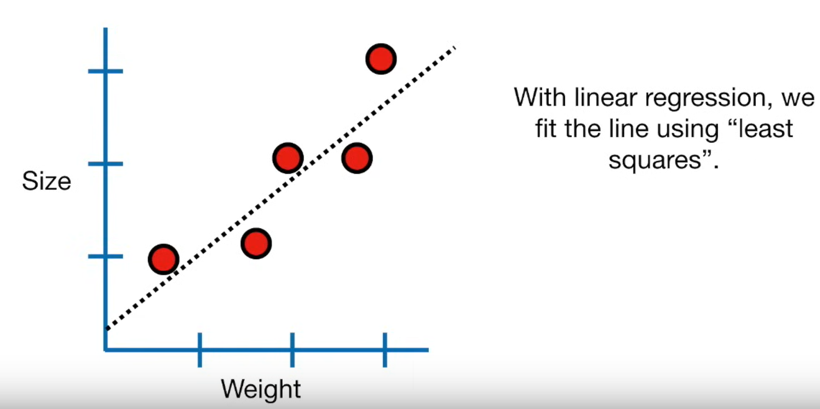
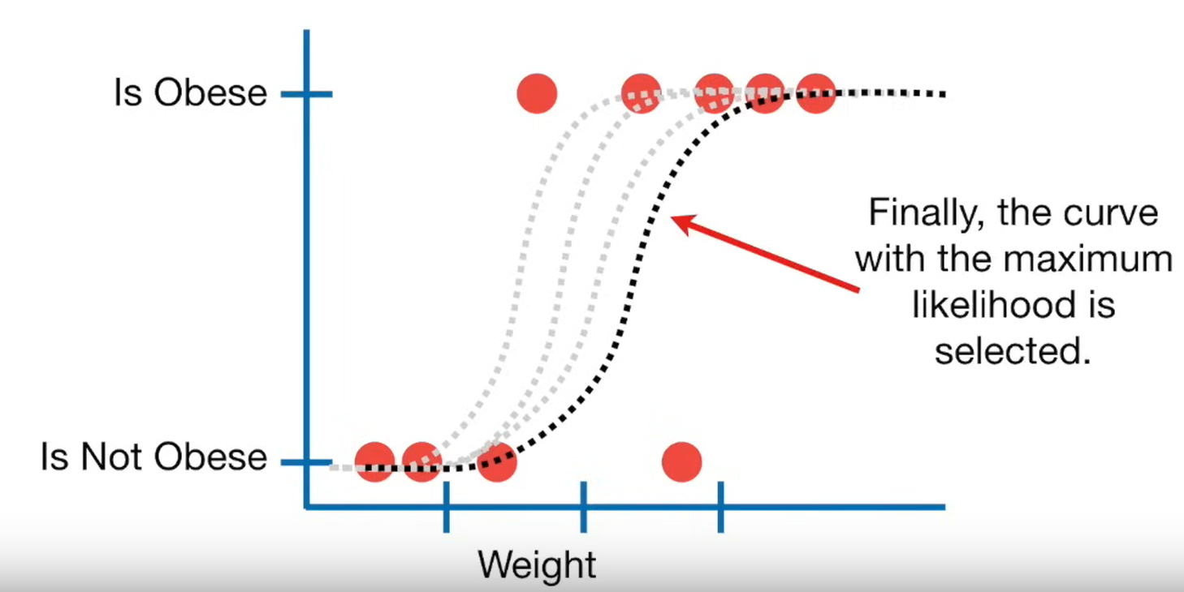
Logistic Regression

Slide 4
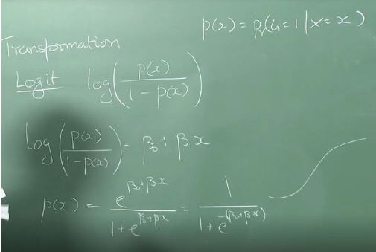
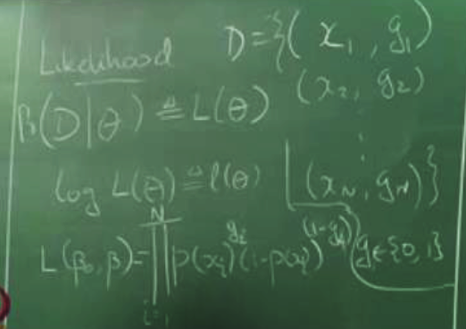
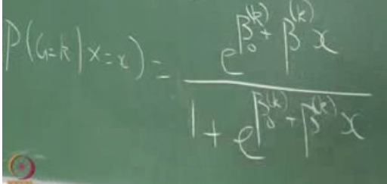


Slide 5
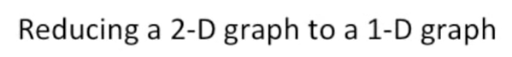
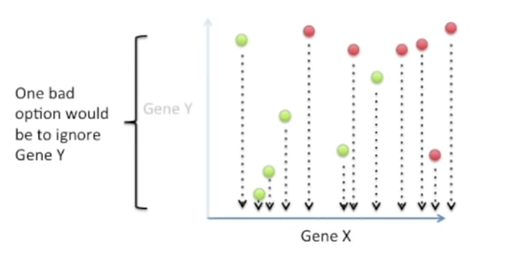
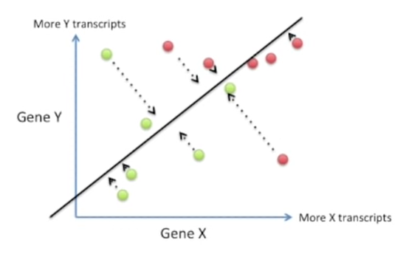
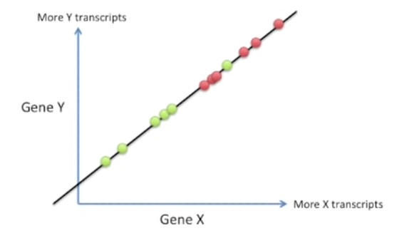
Linear Discriminant Analysis
Linear Discriminant Analysis a dimensionality reduction technique crucial in modeling differences between two classes.
LDA is like PCA, but it focusses on maximizing separability among known classes.

Slide 6
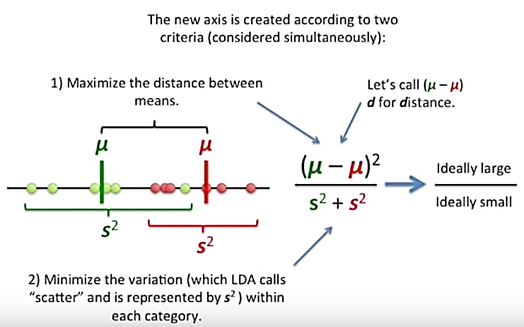
How LDA creates new axis

Slide 7

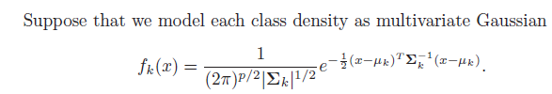
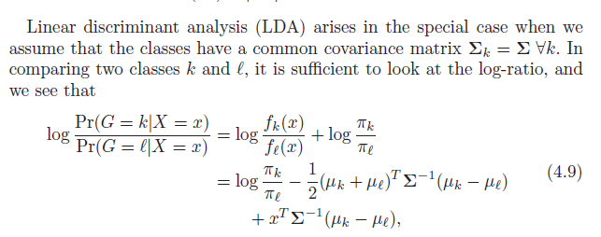

Suppose fk (x) is the class-conditional density of X in class G = k, let πk be the prior probability of class k
This linear log-odds function implies that the decision boundary between classes k and ℓ—the set where Pr(G = k|X = x) = Pr(G = ℓ|X = x)—is linear in x; in p dimensions a hyperplane. This is of course true for any pair of classes, so all the decision boundaries are linear.
The linear discriminant functions

Slide 8
Topics on which Week 3 Assignment Questions are based
Linear Classification
Logistic Regression
Linear Discriminant Analysis

Slide 9
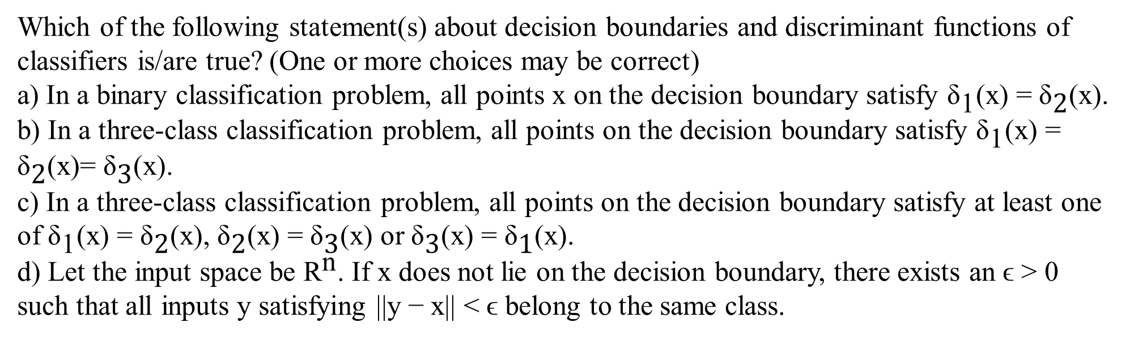
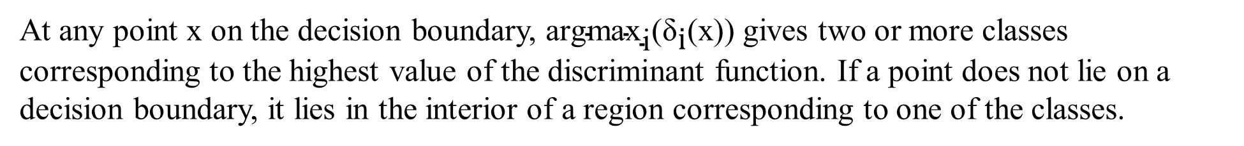
QUESTION 1
SOLUTION 1
CORRECT ANSWER 1
a), c), d)

Slide 10
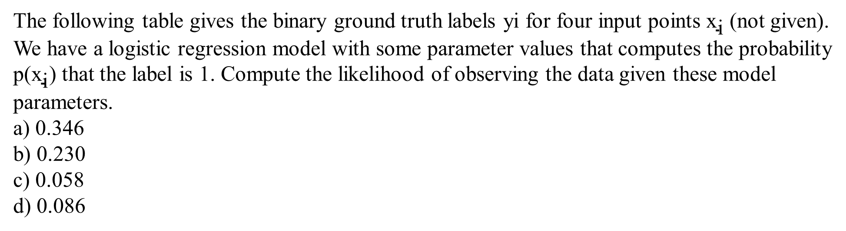

QUESTION 2
Y | 1 | 1 | 0 | 1
 | 0.8 | 0.4 | 0.2 | 0.9
SOLUTION 2
Apply the equation
CORRECT ANSWER 2
b)

Slide 11

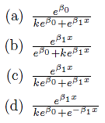
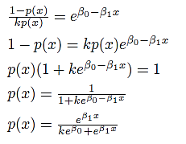
QUESTION 3
Consider a modified form of logistic regression given below where k is a positive constant and
β0 and β1 are parameters.
Then find p(x).
Exponentiating the given equation,
SOLUTION 3
CORRECT ANSWER 3
c)

Slide 12
QUESTION 4
Which of the following statement(s) about logistic regression is/are true?
(a) It learns a model for the probability distribution of the data points in each class.
(b) The output of a linear model is transformed to the range (0, 1) by a sigmoid function.
(c) The parameters are learned by optimizing the mean-squared loss.
(d) The loss function is optimized by using an iterative numerical algorithm.
SOLUTION 4
Unlike LDA, logistic regression does not learn a probability distribution for the data. The optimal parameters are computed by maximizing the log-likelihood.
CORRECT ANSWER 4
b), d)

Slide 13
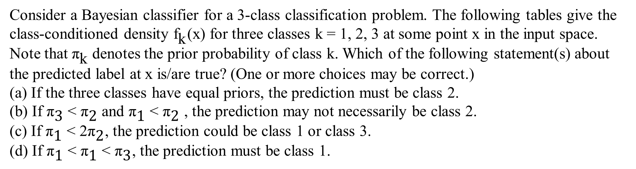
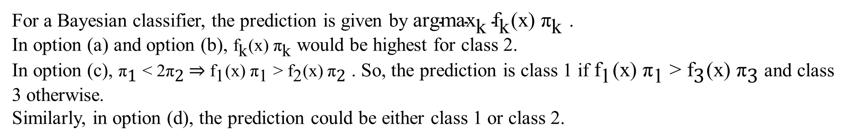
QUESTION 5
k | 1 | 2 | 3
 | 0.15 | 0.20 | 0.05
SOLUTION 5
CORRECT ANSWER 5
a)

Slide 14
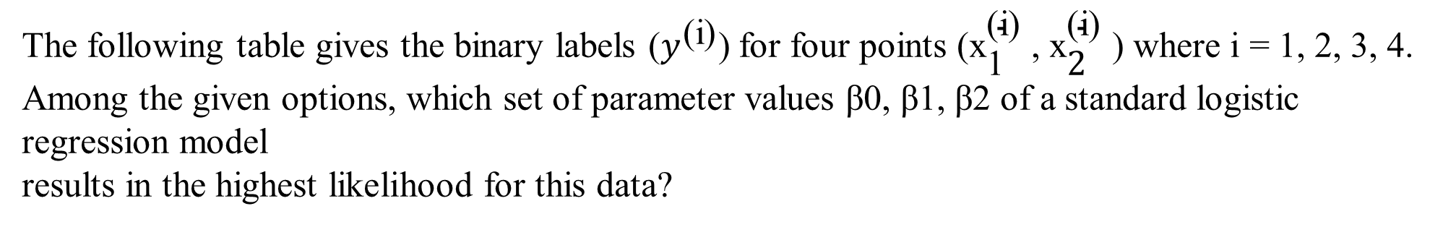

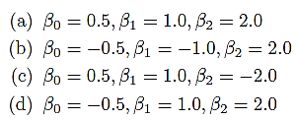

QUESTION 6
x1 | x2 | y
0.4 | -0.2 | 1
0.6 | -0.5 | 1
-0.3 | 0.8 | 0
-0.7 | 0.5 | 0
SOLUTION 6
For each option, first compute the probabilities and then compute the log-likelihood using the following equation.
CORRECT ANSWER 6
c)

Slide 15
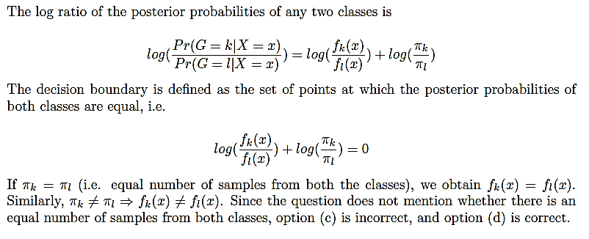
QUESTION 7
Which of the following statement(s) about a two-class LDA model is/are true? (One or more choices may be correct)
a) It is assumed that the class-conditioned probability density of each class is a Gaussian.
b) A different covariance matrix is estimated for each class.
c) At a given point on the decision boundary, the class-conditioned probability densities
corresponding to both classes must be equal.
d) At a given point on the decision boundary, the class-conditioned probability densities
corresponding to both classes may or may not be equal.
SOLUTION 7
Option (a) is true and (b) is false according to the assumptions of LDA.
CORRECT ANSWER 7
a), d)

Slide 16
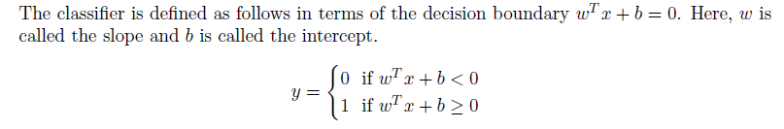
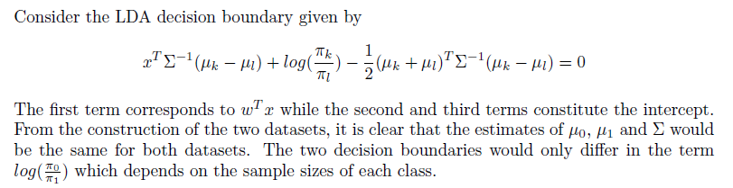
QUESTION 8
Consider the following two datasets and two LDA models trained respectively on these datasets.
Dataset A: 100 samples of class 0; 50 samples of class 1
Dataset B: 100 samples of class 0 (same as Dataset A); 100 samples of class 1 created by repeating twice the class 1 samples from Dataset A
Which of the given statement is true?
(a) The learned decision boundary will be the same for both models.
(b) The two models will have the same slope but different intercepts.
(c) The two models will have different slopes but the same intercept.
(d) The two models may have different slopes and different intercepts.
SOLUTION 8
CORRECT ANSWER 8
b)

Slide 17
QUESTION 9
Which of the following statement(s) about LDA is/are true? (One or more choices may be correct)
(a) It minimizes the between-class variance relative to the within-class variance.
(b) It maximizes the between-class variance relative to the within-class variance.
(c) Both (a) and (b)
(d) Neither (a) nor (b).
SOLUTION 9
LDA maximizes the between-class variance relative to the within-class variance.
CORRECT ANSWER 9
b)

Slide 18
QUESTION 10
Which of the following statement(s) regarding logistic regression and LDA is/are true for a binary classification problem? (One or more choices may be correct)
(a) For any classification dataset, both algorithms learn the same decision boundary.
(b) Adding a few outliers to the dataset is likely to cause a larger change in the decision boundary of LDA compared to that of logistic regression.
(c) Adding a few outliers to the dataset is likely to cause a similar change in the decision boundaries of both classifiers.
(d) If the within-class distributions deviate significantly from the Gaussian distribution, logistic regression is likely to perform better than LDA.
SOLUTION 10
The decision boundaries learned by the two techniques are different because logistic regression uses maximum likelihood estimation (MLE) while LDA performs Bayesian classification by assuming the distribution of each class is a Gaussian.
Since LDA assumes that the underlying intra-class distributions are Gaussian, outliers have a greater effect on LDA compared to logistic regression.
LDA will not perform well if the data does not satisfy the assumptions of the model. On the other hand, logistic regression does not make any assumptions about the data distribution.
CORRECT ANSWER 10
b), d)

